Slide 1


Paidy – Give me some credit Technical exercise
Presenter
Adam Tran

Slide 2
Contents
Introduction
Exploratory data analysis
Model
Validation
Business strategy
Presentation Title

Slide 3

Introductory overview
Two datasets provided :
cs-training: 150k observations, 11 variables with a binary target flag.
Cs-test: This have the same structure as “cs-training”. Since the target variable flag has not been populated, this is mainly used for submissions to Kaggle and hence will not be considered for further analysis.
The aim of the Kaggle competition was to build a model that predicts the probability of someone experiencing financial stress in the next two years

Slide 4


Exploratory data analysis
Exploratory Data analysis

Slide 5
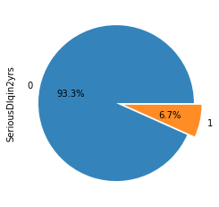
Target variable and variables provided
Variable Name | Description
SeriousDlqin2yrs | Person experienced 90 days past due delinquency or worse
RevolvingUtilizationOfUnsecuredLines | Total balance on credit cards and personal lines of credit except real estate and no installment debt like car loans divided by the sum of credit limits
age | Age of borrower in years
NumberOfTime30-59DaysPastDueNotWorse | Number of times borrower has been 30-59 days past due but no worse in the last 2 years.
DebtRatio | Monthly debt payments, alimony,living costs divided by monthy gross income
MonthlyIncome | Monthly income
NumberOfOpenCreditLinesAndLoans | Number of Open loans (installment like car loan or mortgage) and Lines of credit (e.g. credit cards)
NumberOfTimes90DaysLate | Number of times borrower has been 90 days or more past due.
NumberRealEstateLoansOrLines | Number of mortgage and real estate loans including home equity lines of credit
NumberOfTime60-89DaysPastDueNotWorse | Number of times borrower has been 60-89 days past due but no worse in the last 2 years.
NumberOfDependents | Number of dependents in family excluding themselves (spouse, children etc.)
The target variable is a 90 dpd in 2 years flag. From looking at the target variable, it is highly imbalanced and has high defaults (6.7% of accounts default) compared to a normal lending book. This suggests this is either a subprime book, or in some sort of more risky product type/country e.g. payday lending.
There is a variety of information provided such as
Arrears data: Different indicators if borrower has been in different states of arrears
Borrower specific information: Age, Number of dependants, Monthly Income, Debt Ratio
Credit information: Utilisation of Credit, number of open loans/credit cards, number of mortgages etc.

Slide 6
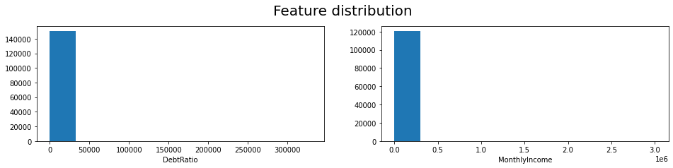
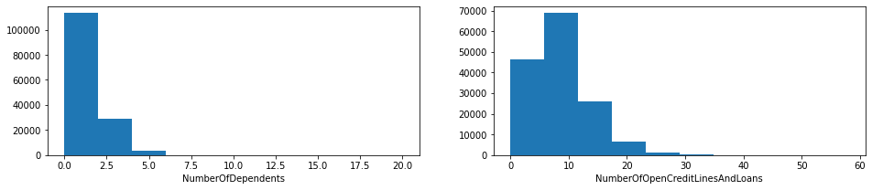
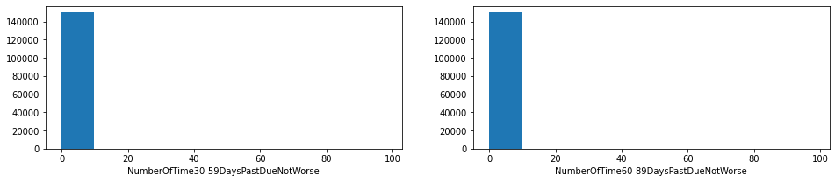

Slide 7
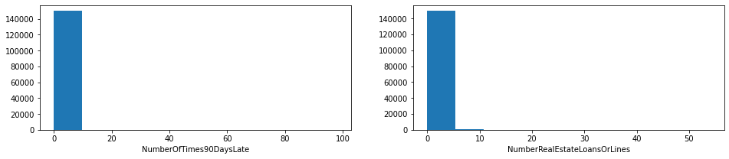
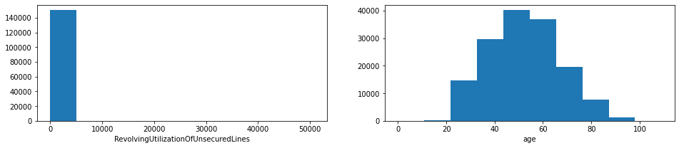
As we can see from the distribution graphs of the predictive variables, there is a lot of white space on some of these charts. This tells us that we have an outlier issue in our data; it is a good idea to account for this prior to modelling as this may cause bias and inefficiencies in our model algorithm.

Slide 8
Outliers and Missing Values
Outliers: Each of the variables that had outliers were individually investigated and treated:
Arrears variables: “NumberOfTime30-59DaysPastDueNotWorse”, “NumberOfTimes90DaysLate”, “NumberOfTime60-89DaysPastDueNotWorse”: All of these variables had values of 96/98 as their outliers. Previous max values range between 11-17 for each of these variables. The default rate of the outliers are significantly high, suggesting that they belong to the high values – the outliers were assigned the max values of that particular variable. (11-17)
Debt Ratio, Monthly Income had significant outliers but this was not judged to be a result of erroneous data collection but rather natural outliers created as a result of extremely low denominators and the natural spread of income. Interestingly, when debt ratio was greater than one, monthly income was always missing; stating that perhaps these high ratios are due to missing income. However, since we do not have further context behind the reason for these high values, it was decided to apply log transformation on the original variables was applied to reduce the effect of outliers.
Revolving Utilisation was also problematic – with a mean of six. This was driven by some extremely large value (50708 being the highest). There were 254 accounts where this was higher than 5, and the average default rate of these accounts were checked. It was seen that there default rate was relatively benign, hence suggesting this is more of an data error issue. It was decided to drop these accounts from our training data.
Missing Values: Only two variable had missing information; Monthly Income and Number of dependants. For number of dependants, it felt appropriate to assign it 0 if missing. For monthly income, due to the uncertain nature of why data was missing, it was decided to leave that as missing as XGBoost is, by it’s nature, highly suited to dealing with missing data. Inferring too much at this stage for monthly income would be a risk.

Slide 9
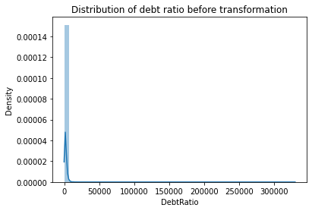
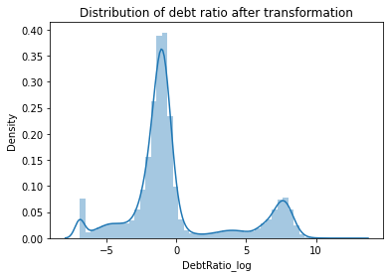
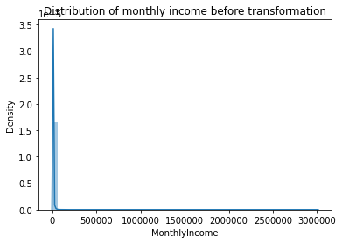
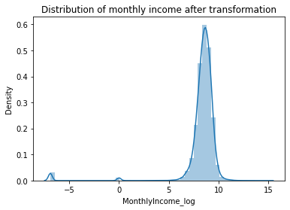
Outliers and Missing Values
Note: Since this is a Kaggle competition, it would have been important for me to also check the distribution of the submission dataset and seeing if these issues also occur in the submission dataset to obtain the highest possible score. Since this is more of a technical exercises and there is no need to submit to Kaggle, I have focused my analysis purely on the distributions of this dataset.

Slide 10
Feature Engineering
Although machine learning algorithms are powerful and largely autonomous, improvements in model performance can still potentially be obtained through careful feature engineering.
Monthly income per person of household: This is calculated by dividing the monthlyincome by the number of dependents the borrower has.
Monthly debt: This is calculated by reversing the Debtratio, by multiplying that by the monthly income to obtain the monthly debt.
Retired flag: This is flagged using age (>65) and monthly income=0

Slide 11
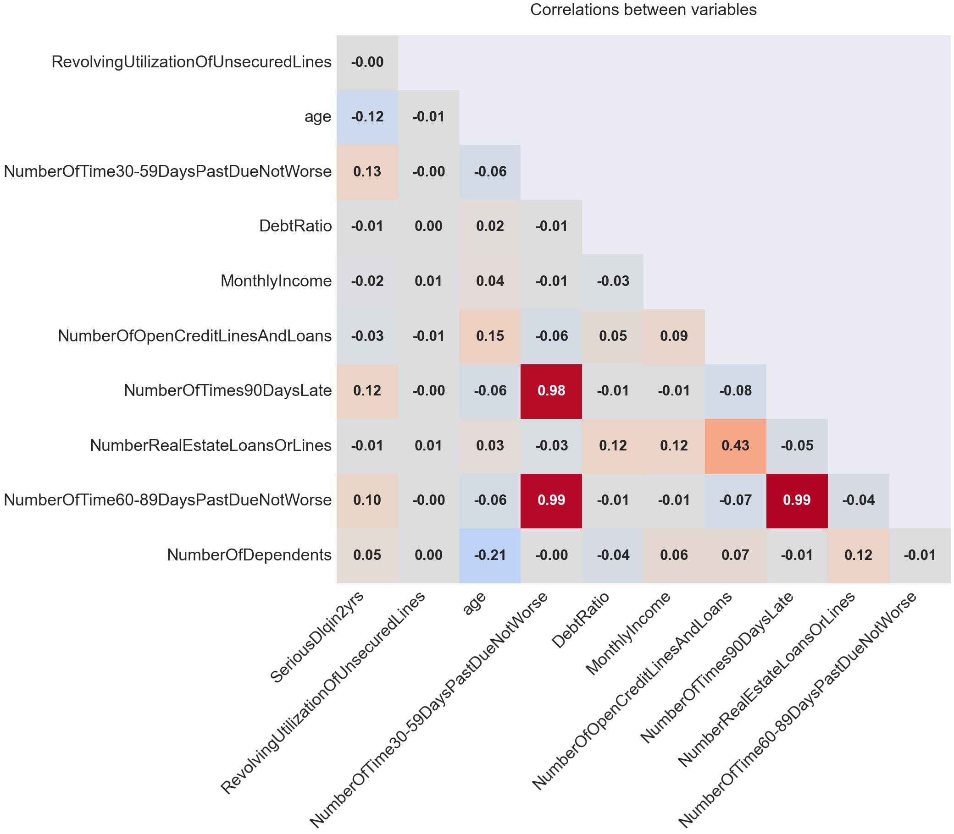
Overview of correlations
It is clear that there exists significant correlation between the independent variables – for example between the arrears variables. It was considered to remove some of these variables given the high strength of correlation, but given the robustness of the XGBoost algorithm to multicollinearity, this was discarded.
It is interesting to see there is a negative correlation between age and the target variable; this could be as age increases, risk of default lowers.

Slide 12
Information Value
A simple decision tree was used to create bins of the numerical variables. The information value of each variable was then calculated.
Revolving utilisation comes out at the strongest variable, followed closely by the arrears variables. Borrower information (such as age, monthly income and number of dependants does not feature that highly).

Slide 13
Model
Model: xgboost

Slide 14
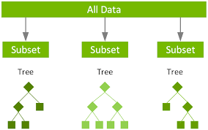
Choice of model algorithm
Sample was divided into an 80% training set and a 20% validation set.
XGBoost was the choice of algorithm to use – it is an algorithm that uses a sequence of decision trees to make predictions. It is a type of ensemble learning method, which means that it combines the predictions of multiple weak learners to produce a stronger prediction.
It was chosen for the following reasons:
Highly predictive model
Efficient handling of missing data
Relatively fast training algorithm
Basic hyperparameter tuning was done along with cross fold validation to determine the best set of hyperparameters to use.

Slide 15
Hyperparameters + tuning approach
Grid search was the method that was used to tune the hyperparameters. It involves specifying a set of possible values for each hyperparameter, and then training and evaluating the model for each combination of hyperparameter values. Grid search is simple to implement and can be efficient when the number of hyperparameters and their possible values is small.
A variety of common hyperparmeters; the subset given to search is a list of common starting values.
Bayesian optimisation was considered but is somewhat difficult to implement. Considering the goal of the task is not to develop the best performing model, it was decided Xgboost would be used as an MVP.

Slide 16
Important XGBoost Hyperparameters
Number of Trees
Lambda
Higher number of trees leads to more complex model but more prone to overfitting
Penalizes the model for having non zero weights –prevents overfitting by forcing model to have sparser solutions (less different types of variables)
Learning Rate
Controls how fast the model learns from data – higher values lead to faster training but may not converge to good solution
Depth of each tree
Alpha
Deeper trees can infer more complex relationships but also prone to overfitting
L1 regularization parameter that penalizes models for having large weights – makes it learn more general patterns

Slide 17
Validation
Validation

Slide 18
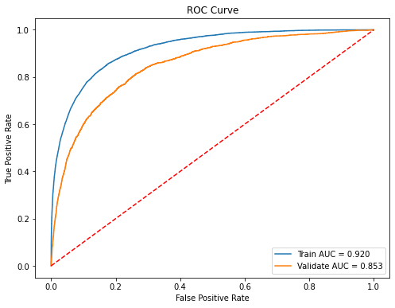
Overall metrics
Overall model performs powerfully, with a train AUC of 0.92 and a validate AUC of 0.853
Other metrics also performs well; accuracy is around 97.5% with a F-score of approximately 21.
Model | MSE | RMSE | MAE | MSLE | RMSLE | Accuracy Train | Accuracy Test | F-Beta Score (Î²=2)
XGBoost | 5.13 | 2.26 | 9.73 | 2.51 | 1.58 | 97.68 | 97.44 | 21.72

Slide 19
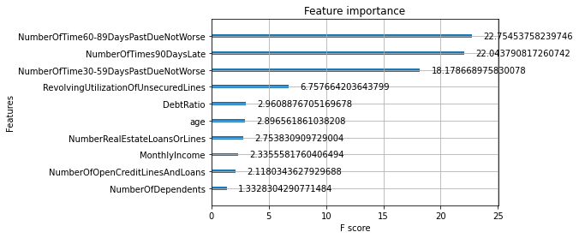
Feature importance
The graph on the right shows the importance of each variable to the model. It is calculated based on the “gain” metric - how well a feature splits the data into groups of different target values.
From what we can clearly observe, the arrears information variables are most predictive which is as expected. Following this is more specific credit information (e.g. utilisation, debt ratio, number of loans etc.). Borrower specific information plays the least importance to the model.

Slide 20
Business strategy
Business strategy

Slide 21



So we built a model…now what?
Trade off: Profit v Volumes
The model built through utilizing this dataset can be used in many ways; the most obvious way is to be used in credit decisioning. The following slides present two scenarios in which the model can be used and illustrates the benefits this model can bring.
Used in loans decisioning
The model built can be used to accept or reject a potential borrower for a loan. A cut-off, based on the probability of default, can be set by the institution to determine what applications to accept or reject.
Setting limits of credit cards
It can also be used to decide limits of customers. Imagine a scenario where it can be used to decide how high a limit customers will receive when they obtain a credit card. Higher limits will be given to less risky borrowers and vica versa. This is a management strategy that can reduce bad debt and optimize profit.

Slide 22
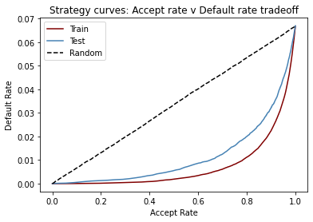
Scenario: Credit decisioning
The graph on the right shows the accept rate to default rate trade off for the model we built (train/test) to a random model.
It is clear the improvement having a powerful model brings; for a given accept rate, you are obtaining a far lower default rate compared to a random model. This will reduce bad debt and optimise profit.
It also illustrates the volume / profit trade off – if you want to increase the accept rate, the costs of that is higher default rates. The choice of where you want to go on the curve will depend on the overall business strategy of the lender.

Slide 23
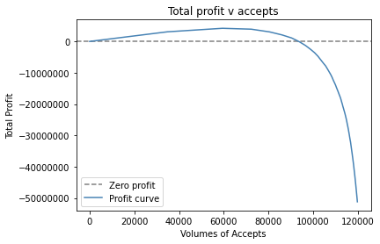
Scenario: Credit decisioning
This is even better illustrated by making some simplifying assumptions:
We assume that the operating income of a loan is around £100, the LGD is 80% and the EAD is around £10,000.
Profit is defined as Operating Income – Bad Debt (PDxEADxLGD).
By adjusting our cut-off strategy (where we set the accept rate), we can control whether we are optimising for growth or profit.
Profit: We would set the accept rate at the point where the curve is highest (c.60k)
Growth but no profit: We would set the accept rate at a point where Total profit is equal to zero.
Super growth at a loss: We would set the accept rate at a total loss level the business was willing to accept.

Slide 24

Further possible strategies
Of course, the scenario illustrated previously is extremely simplistic in nature, but demonstrates the key ideas of credit decisioning.
Another more realistic strategy would be to:
Decline the most risky group of customers
Accept the riskier group of customers but give them small loans as a risk management technique
Offer larger loans to the least risky group of customers.
In practice, risk and income are two sides of the same coin; the best possible strategy would take into account both risk and income and the overall arching business strategy.

Slide 25
Future work
This was a quick proof of concept model developed for a technical exercise. Many of the modelling decisions was made with further future iterations in mind. Further work and potential avenues of analysis include:
Trial other model algorithms e.g. LightGBM, Neural nets, SVMs etc
Greater feature engineering – creation of different features
More careful handling of outliers and missing values
More exhaustive and tuning of hyperparameters
Consider greater potential credit strategy options and illustrate the pros and cons of each approach.

Slide 26
Any questions?

Slide 27




Thank you
Adam Tran
adamt0309@gmail.com
https://www.linkedin.com/in/adam-tran-20b80b43/
https://github.com/adamt0309/Kaggle-Credit-Paidy-technical-exercise

